Slide 1
Using the MDPHnet Query Composer Tool - Creating your first query
Prepared by Aileen Ochoa, Harvard Pilgrim Health Care Institute,
Aileen_Ochoa@harvardpilgrim.org
July 18, 2018, draft v0.2

Slide 2
Link to MDPHnet Query Tool
https://querytool.mdphnet.org
You can request an account from this page or find your password.

Slide 3
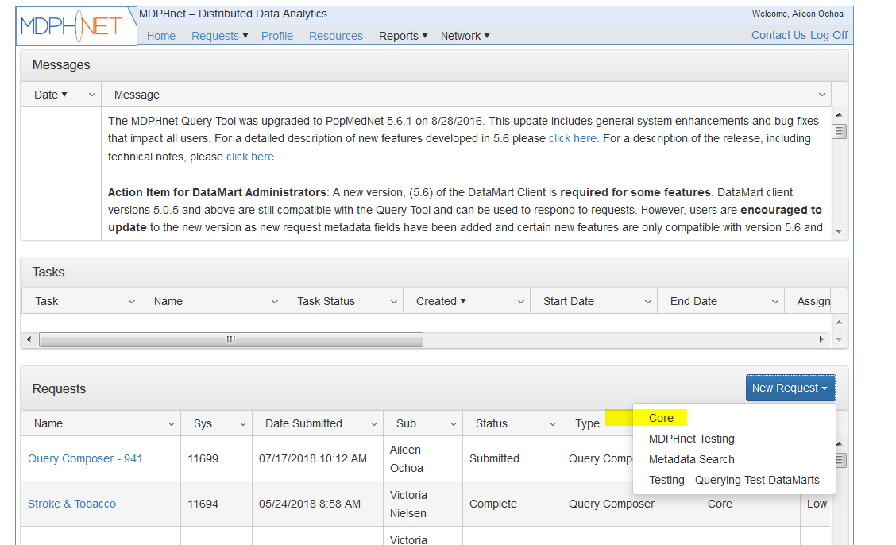
Home page
Click on New Request and then Core to create a query against the MDPHnet database.

Slide 4
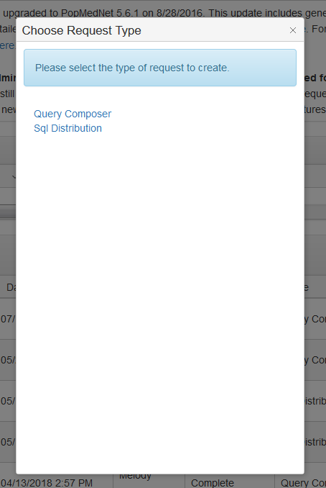
Request Type
Select desired request.
Query Composer is the guided tool for helping create a query.
SQL Distribution is for submitting an already written SQL query.
The following slides assume you want to use the Query Composer tool.

Slide 5
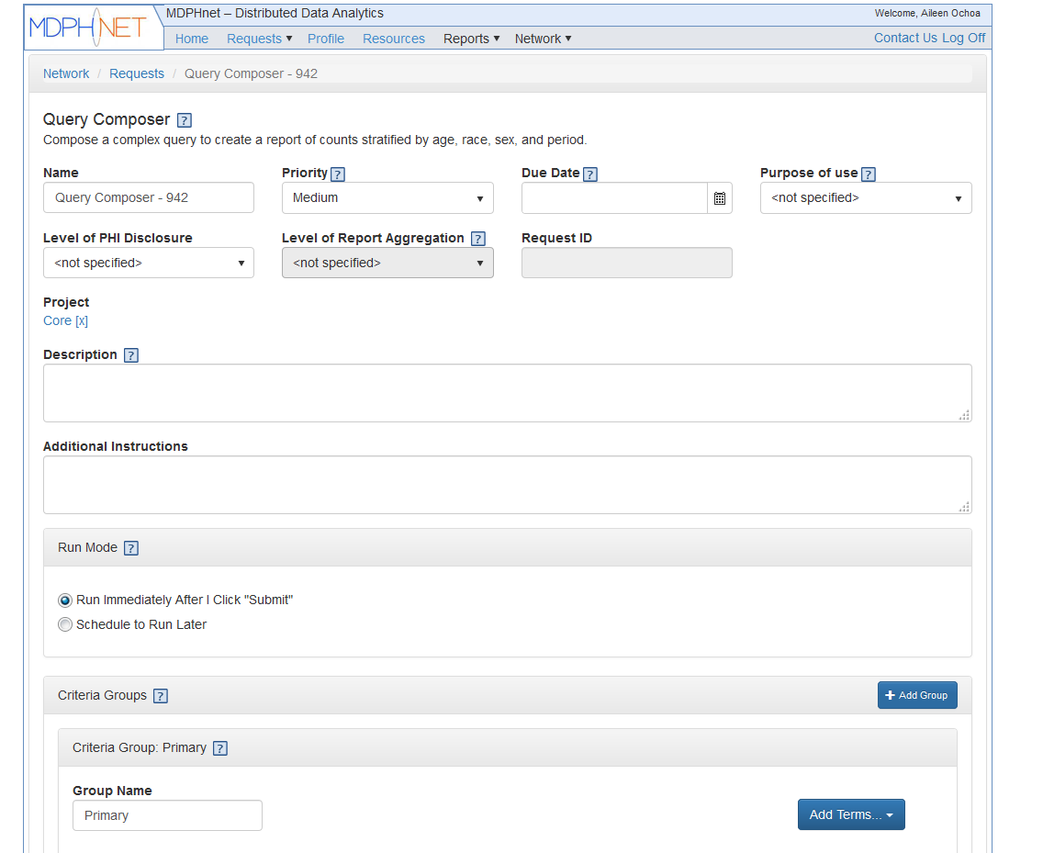
Request Form – Query Information
You can click on the ? box throughout for helpful information on each field. Click the ? again to close the information box.
Here you can name your query, put in a description, and put your priority level and due date if needed.
This information is used by the MDPHnet sites when they log-in to review the query run.

Slide 6
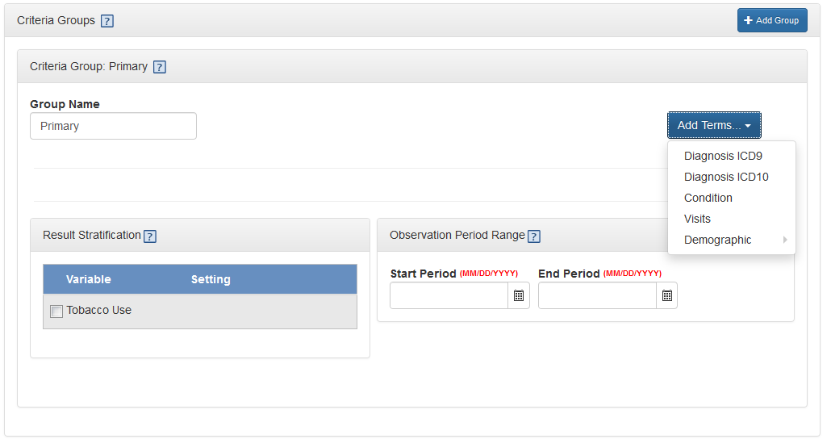
Request Form – Criteria Groups
In this section, you can define your cohort.
First you select a primary group using any of the Add Terms options.
For example, you can select Diabetes as a condition.
You can also add visit and demographic criteria to your primary group by clicking Add Terms again.
Note: the criteria group must contain at least a Diagnosis, Disease, or Visits term.
To remove a term from the query, click the [X] control on the upper right of the term.

Slide 7
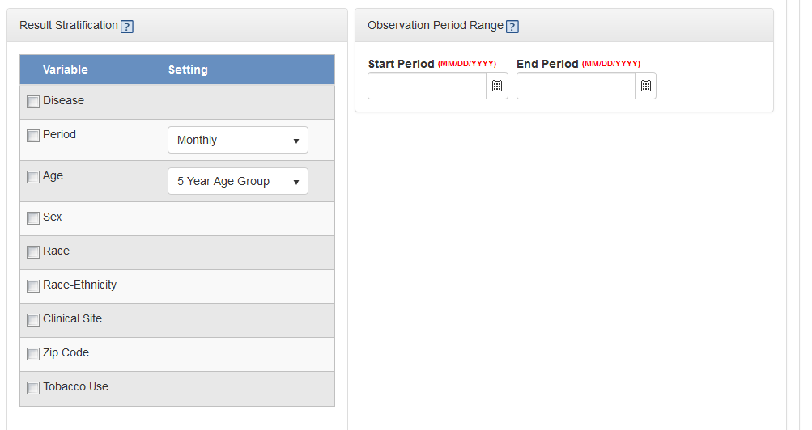
Request Form – Stratification and Observation Period
You can view stratified results by selecting the variables you want to stratify by.
You can set the time period for your cohort in Observation Period Range

Slide 8
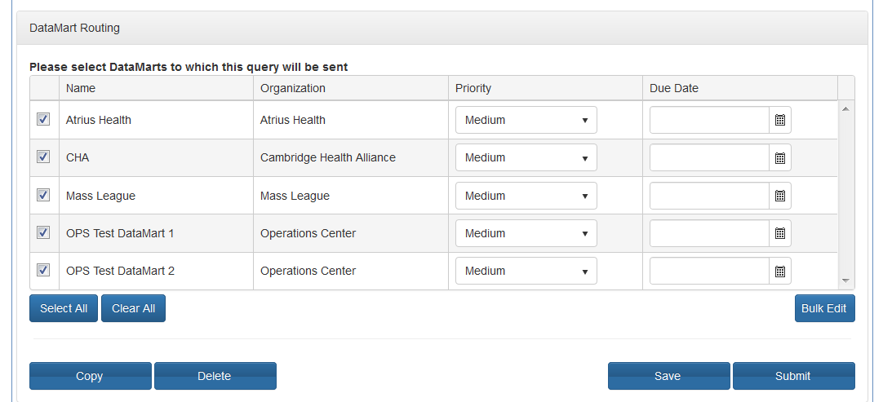
Request Form – DataMart and Submit
Select which MDPHnet sites should receive your query request.
Atrius Health, Mass League of Community Health Centers, Cambridge Health Alliance
OPS Test DataMart 1 and 2 are used to test the query against a dummy dataset.
Hit Submit to send your query to each site.
You can also Save and come back later to edit your query before submitting.

Slide 9
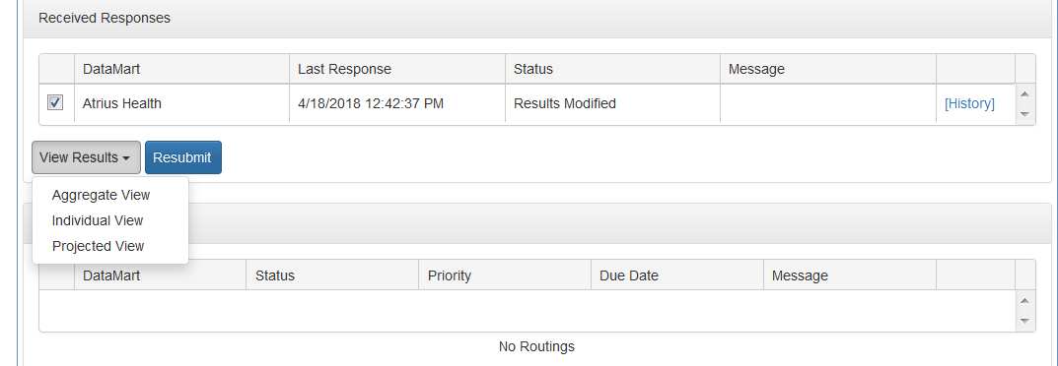
View Results
You will get an email notifying you when your query has finished running at each site.
Log in and click on your query name from home page. On the next page, you will see a button near the bottom that says “View Results”.
Aggregate view is a table level view of results
Individual view is the same as aggregate but divided by data partner
Projected view shows estimates of prevalence with corrections based on US Census Data.
More information: https://popmednet.atlassian.net/wiki/spaces/DOC/pages/16842824/ESP+Query+Composer+Projections
Note not all views are available depending on the structure of your query.

Slide 10
Helpful Tips
Breaking up your desired results into multiple queries may be easier than trying to submit one query that has everything you want.
It is very common to run a query and realize after you view results that you need to make adjustments. You can easily open your original query, edit, then resubmit through the tool.
Commonwealth Informatics can provide guidance on a complicated query
It might be necessary to run a SQL script using SQL distribution request if the Query Composer can’t give the results you want.

Slide 11
More Information
PopMedNet Wiki has detailed documentation on how to use the Query Composer
https://popmednet.atlassian.net/wiki/spaces/DOC/pages/8880241/PopMedNet+User%27s+Guide
Specific helpful pages
Creating a Primary Group https://popmednet.atlassian.net/wiki/spaces/DOC/pages/8880336/Query+Composer+Request
Viewing Results https://popmednet.atlassian.net/wiki/spaces/DOC/pages/8880347/Viewing+Request+Results

