Slide 1
Sample MDPHnet queries
Request | Type of Query | Description | Purpose
Stroke and triglycerides | SQL Distribution | Number of people with stroke grouped by triglyceride levels in 2018-2019 | Presented at APHA 2019; currently being developed into a paper.
Stroke and Depression | SQL Distribution | Number of people with stroke and depression in 2018-2019 | Presented at APHA 2019; currently being developed into a paper.
Stroke and Tobacco use | Query Composer | Number of people with stroke stratigied by age group, sex, race-ethnicity, tobacco use for 2018-2019 | Presented at APHA 2019; currently being developed into a paper.
Controlled Hypertension Numbers | SQL Distribution | Number of people with controlled hypertension in 2018 based on dx code and MDPHnet definition stratified by age group, sex, race-ethnicity | Program evaluation; grant application.
Native American Counts with Diabetes | Query Composer | Number of people with Diabetes type 1 and 2 of Native American/Alaskan race from Jan 2017 - Dec 2018
Hypertension Prevalence | Query Composer | Number of people with hypertension based on dx code stratified by age group, sex, race-ethnicity in 2017 | Program evaluation; grant application.
Denominators | Query Composer | Number of people with at least one patient visit in 2017 by age group, sex, race-ethnicity
Homelessness and Diabetes | Query Composer | Housing status counts by zip code and age group, sex, race-ethnicyt | Presented at DPH conference; currently being developed into a paper.
Homelessness Numbers | SQL Distribution | Number of people with housing_status corresponding with homelessness from Mass League data | Presented at DPH conference; currently being developed into a paper.
Anxiety Numbers | Query Composer | Number of people with Anxiety defined by diagnosis code in 2018 stratified by month, age-group, race-ethnicity | Data QA
Depression and Dysthymia Numbers | Query Composer | Number of people with depression and dysthymia defined by diagnosis code in 2018 stratified by month, age-group, race-ethnicity | Data QA
Stroke by Tobacco Use | Query Composer | Number of people with history of stroke defined by diagnosis codes stratified by age-group, sex, race-ethnicity, and tobacco use from 2017-2018 | Presented at APHA 2019; currently being developed into a paper.
High Cholesterol Numbers | SQL Distribution | Number of people with high cholesterol as defined by lab test results in 2018 stratified by sex, race-ethnicity | Program evaluation.
Prediabetes Numbers | SQL Distribution | Number of people with pre-diabetes as defined by diagnosis codes and lab test results from 2018 stratified by sex, race-ethnicity | Program evaluation.
Triglycerides, HDL, LDL and Stroke | SQL Distribution | Number of people with ischemic stroke defined by ICD code and lab results from 2017-2018 stratified by age-group, sex, race-ethnicity (3 queries) | Presented at APHA 2019; currently being developed into a paper.
Undiagnosed Hypertension | SQL Distribution | Number of people with undiagnosed hypertension defined by lab results and vital signs with at least 2 encounters in the associated time period stratified by age-group, sex, and race-ethnicity | Program evaluation; grant application.
Notifiable
Disease Reporting
Notes:
The following slides from Vickie Nielsen discuss results of the highlighted queries.

Slide 2
Special Populations: Homeless
Obtaining clinical data on homeless populations is challenging.
Federally Qualified Health Centers are required to ask about homelessness and housing insecurity:
Street.
Homeless shelter.
Notifiable
Disease Reporting

Slide 3
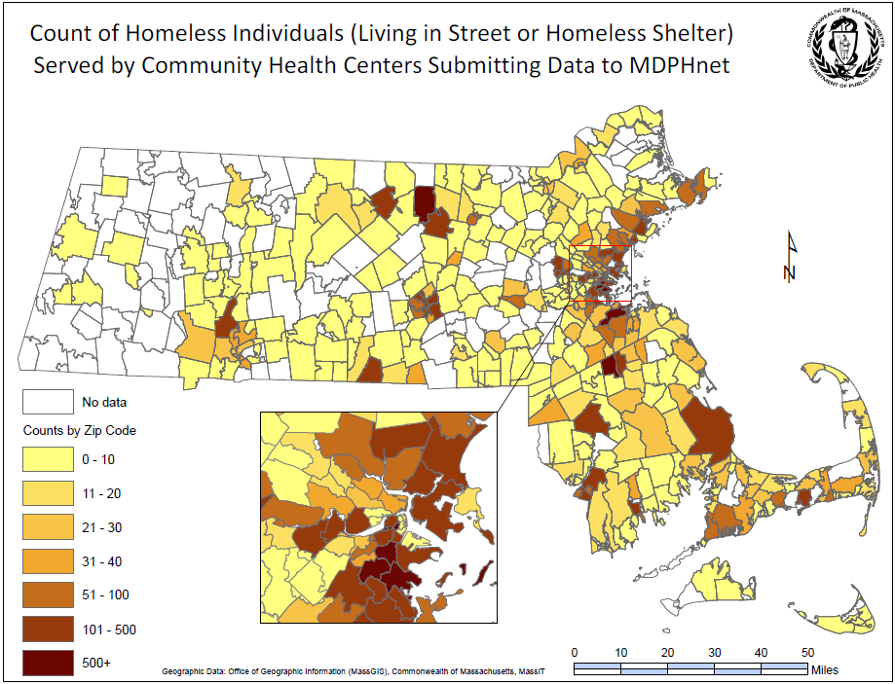
Notifiable
Disease Reporting

Slide 4
Clinical Data-Medically Complex
Obtaining granular data on patients with a medical history is a challenge, particularly if estimates by multiple strata are desired.
Notifiable
Disease Reporting
Race, Ethnic, Age, or Other Demographic
Comorbidity or Condition of Interest
Medical History

Slide 5
Clinical Data-Medically Complex
Paul Coverdell National Acute Stroke Program.
Data is needed to guide post-acute efforts (i.e., after stroke patients are discharged from the hospital).
Estimating modifiable risk factors for subsequent stroke among patients with stroke history.

Slide 6
Clinical Data-Medically Complex
12,754 patients with history of stroke or TIA
8,983 white, NH
1,399
black, NH
487
Asian, NH
728
Hispanic

Slide 7
Clinical Data-Medically Complex
12.9% are current smokers
WHITE,
NH
BLACK,
NH
ASIAN, NH
HISPANIC
12.5%
14.1%
10.5%
16.8%

Slide 8
Clinical Data-Medically Complex
29.5% have elevated BP at last visit
WHITE,
NH
BLACK,
NH
ASIAN, NH
HISPANIC
27.3%
40.9%
28.3%
32.4%

