Slide 1
Quick Guide Using the MDPHnet Query Composer Tool
Revised by Thuy Nguyen, Harvard Pilgrim Health Care Institute,
Vu-Thuy_Nguyen@harvardpilgrim.org
Updated September 20, 2023

Slide 2
MDPHnet Query Tool Purpose
To enable MDPH to query EMR data in near-real time from 3 real-world health care settings in Massachusetts while allowing these institutions to retain complete control of their data
Cambridge Health Alliance
Atrius Health
Massachusetts League of Community Health Centers
Data have been used for public health surveillance, evaluation of public health initiatives, explore novel analysis questions, and to inform grant submissions

Slide 3
MDPHnet Query Tool Link
https://querytool.mdphnet.org
You can request an account from this page or find your password.
For New DPH users, please contact Emily Neumann emily.neumann2@mass.gov for a copy of the New User Request Form; please complete and send back to Emily.

Slide 4
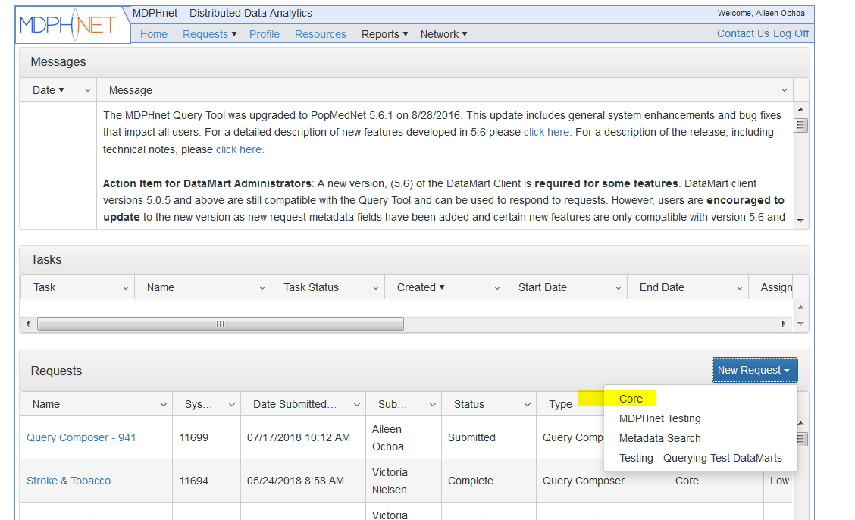
Home page
Click on New Request and then Core to create a query against the MDPHnet database.
Note: Access to the tool is white-listed by IP address to Atrius, CHA, MLCHC, MDPH, and DPM. If you are working from home, you will need to connect to your work VPN first.

Slide 5
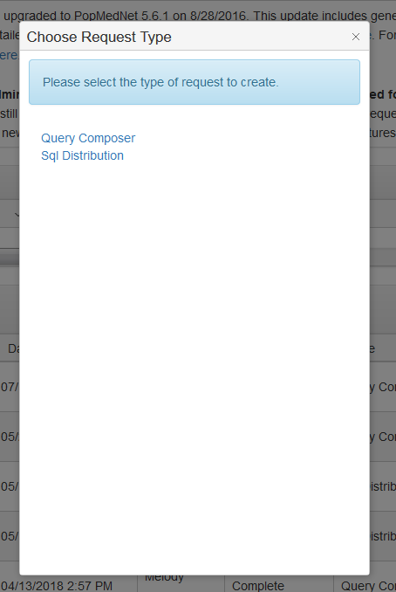
Request Type
Select desired request.
Query Composer is the guided tool for helping create a query.
SQL Distribution is for submitting an already written SQL query.*
The following slides assume you want to use the Query Composer tool.
*SQL queries are needed if you want to query lab results or medications and can be useful to consolidate multiple queries into one. Please contact Catherine Rocchio crocchio@commoninf.com for more questions on creating a SQL query.

Slide 6
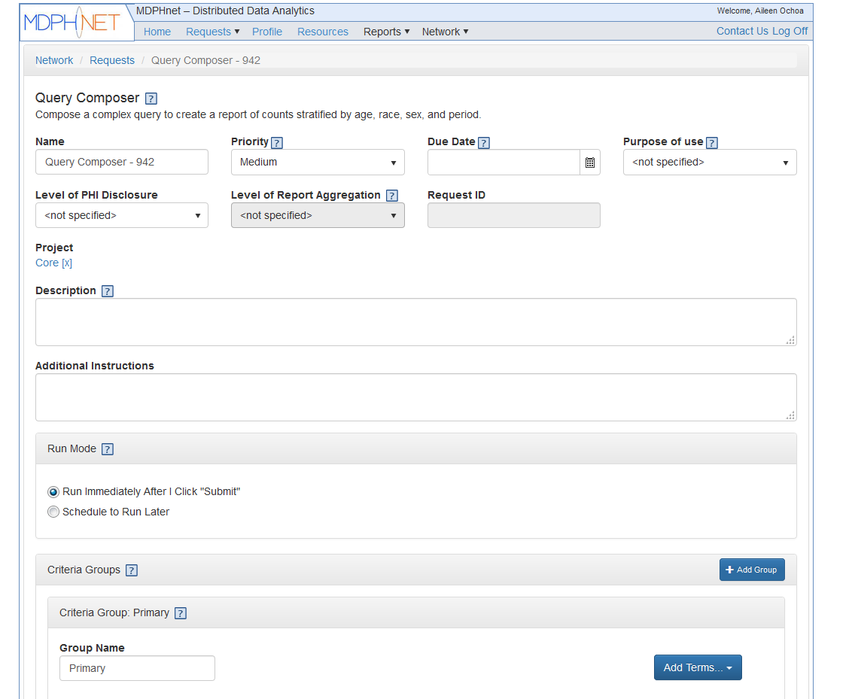
Request Form – Query Information
You can click on the ? box throughout for helpful information on each field. Click the ? again to close the information box.
Here you can name your query, put in a description, and put your priority level and due date if needed.
This information is used by the MDPHnet sites when they log-in to review the query run. Please make sure to include a priority level and due date, if time sensitive.

Slide 7
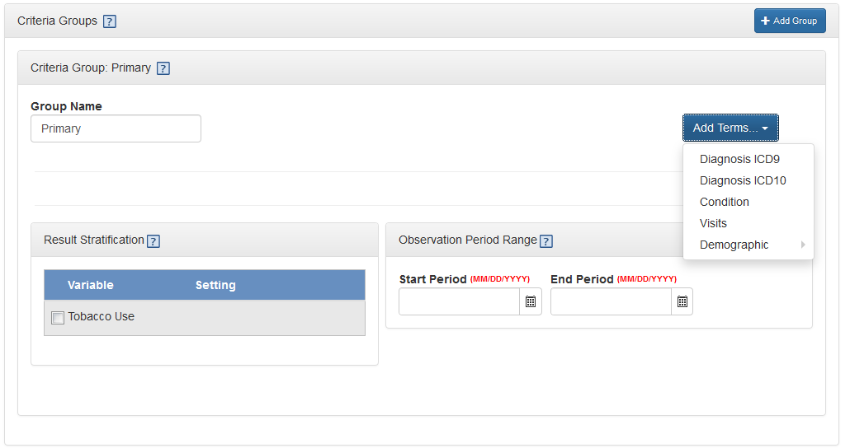
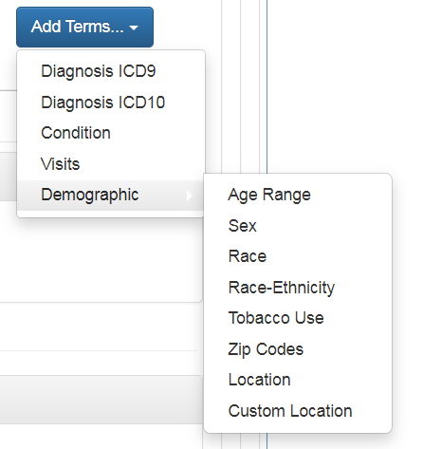
Request Form – Criteria Groups
In this section, you can define your cohort.
First you select a primary group using any of the Add Terms options.
For example, you can select Diabetes as a condition.
You can also add visit and demographic criteria to your primary group by clicking Add Terms again.
Note: the criteria group must contain at least a Diagnosis, Disease, or Visits term.
To remove a term from the query, click the [X] control on the upper right of the term.

Slide 8
Visits/Encounters
You can limit your query to return results only among patients with a specific number of encounters at the health center during your time period
We define visits or clinical encounters as encounters where at least 1 of the following was recorded
Vital sign (blood pressure, height, weight, temperature)
Diagnosis code
Immunization
Prescription
Laboratory test

Slide 9
Conditions in MDPHnet
DPM has defined several conditions in MDPHnet directly
Asthma
Diabetes, Type 1 and 2 & Gestational
Pre-diabetes
Hypertension
Depression
Influenza-like Illness
Opioid prescription & Benzodiazepine prescription
Link to full algorithms here
You can also specify conditions or diseases by ICD-9 or ICD-10 codes
There are two ways to select the codes: Search by specific code (including decimal, for 4 and 5 digit codes), range of codes (e.g., 250-251, 250.1-255.1, or 296.00-296.99) OR
Choose a category and select from a list. The list shows code and name. Click on the column header to sort by code or by name. Click on Add Codes to add the selected codes to the list and display the list.

Slide 10
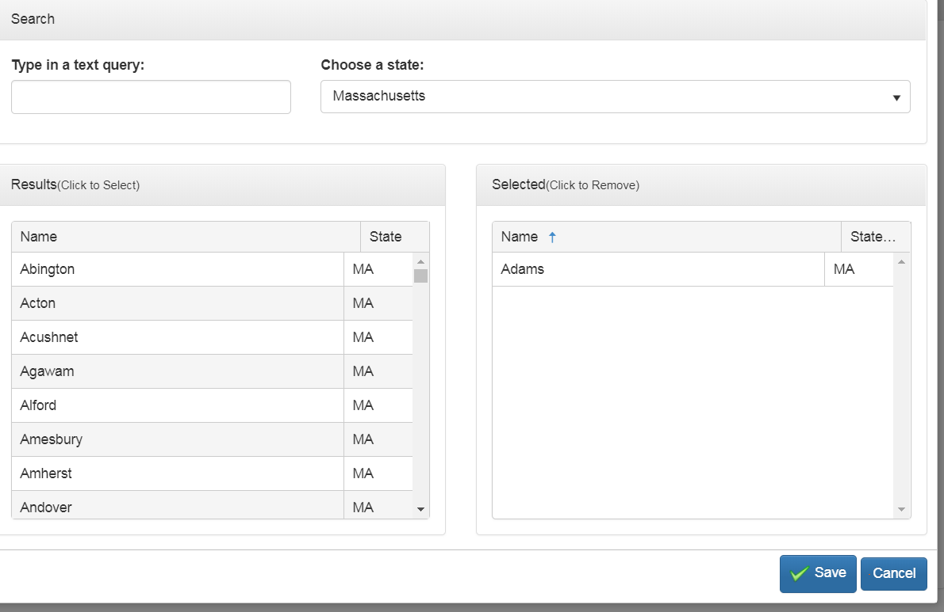
Zip code/location
You can select MA locations by selecting zip code or you can select the town names programmed into the Query Tool
If you want results for all of MA by town, then you will need to select all the town names into your query

Slide 11
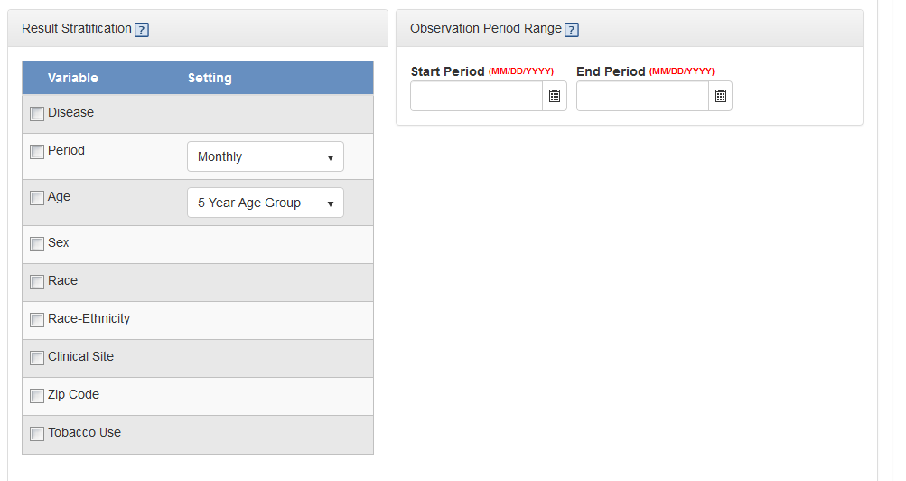
Request Form – Stratification and Observation Period
You can view stratified results by selecting the variables you want to stratify by.
You can set the time period for your cohort in Observation Period Range

Slide 12
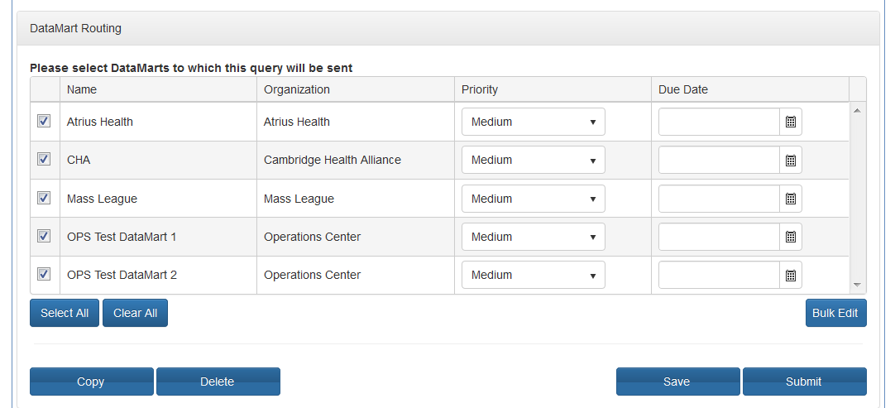
Request Form – DataMart and Submit
Select which MDPHnet sites should receive your query request.
The term “data marts” are used to refer to participating sites.
OPS Test DataMart 1 and 2 are used to test the query against a dummy dataset.
Atrius, CHA, and Mass League users only have access to their respective sites.
Hit Submit to send your query to each site.
You can also Save and come back later to edit your query before submitting.

Slide 13
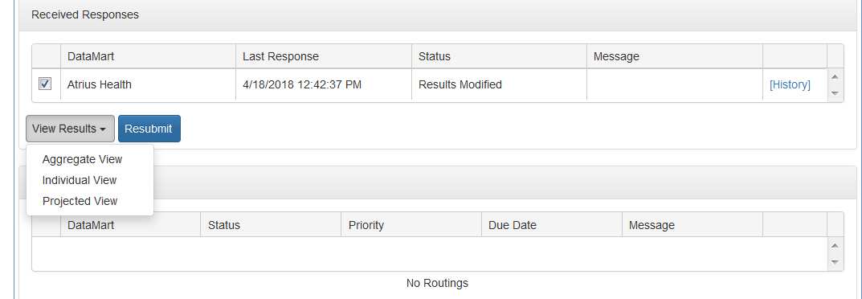
View Results
You will get an email notifying you when your query has finished running at each site.
Log in and click on your query name from home page. On the next page, you will see a button near the bottom that says “View Results”.
Aggregate view is a table level view of results
Individual view is the same as aggregate but divided by data partner
Projected view shows estimates of prevalence with corrections based on US Census Data.
Note not all views are available depending on the structure of your query.
You can download results into an Excel or CSV file. Results may take some time to load depending on size

Slide 14
Note on Stratification
The patient counts are unique within the designated reporting period (e.g., month-year). For instance, you send an ICD-9 query for 250.1 from 1/2012 through 4/2013 and a person is coded with this in 2/2012, 6/2012, and 2/2013. If the result is stratified by year and month, the patient would be counted in three stratifications. If the query was stratified by year, the patient would be counted twice – one count for each year. A patient can only be counted once per stratification. To prevent double-counting, DO NOT sum person counts across periods.

Slide 15
Projected View
Helps correct for skewed patient demographics among a network's data partners and provides estimated patient counts for locations not covered by the data partners.
Uses a dataset from the 2010 U.S. Census to generate three sets of stratified patient counts: observed patients, adjusted patient count, and projected patient count.
Evaluated against results from the Behavioral Risk Factor Surveillance System (BRFSS) state and small-area estimates.
Please see this document for in-depth guidance on using the Projected View

Slide 16
SQL Queries
Pre-written SQL queries can be submitted directly into the query tool.
Used for lab results, medications, vital signs, and to consolidate queries that otherwise would need multiple runs using the query tool
Please contact Catherine Rocchio crocchio@commoninf.com for more questions on creating a SQL query.

Slide 17
SQL Query Example
This part of the code returns counts by age group as calculated from 1/1/2018
This is an example of a query submitted as raw SQL. This specific query example gives counts of patients receiving care
select count(distinct patid), CASE when date_part('year', age('01-01-2018', public.emr_patient.date_of_birth)) <= 9 then '0-9' when date_part('year', age('01-01-2018', public.emr_patient.date_of_birth)) <= 19 then '10-19' when date_part('year', age('01-01-2018', public.emr_patient.date_of_birth)) <= 29 then '20-29' when date_part('year', age('01-01-2018', public.emr_patient.date_of_birth)) <= 39 then '30-39' when date_part('year', age('01-01-2018', public.emr_patient.date_of_birth)) <= 49 then '40-49' when date_part('year', age('01-01-2018', public.emr_patient.date_of_birth)) <= 59 then '50-59' when date_part('year', age('01-01-2018', public.emr_patient.date_of_birth)) <= 69 then '60-69' when date_part('year', age('01-01-2018', public.emr_patient.date_of_birth)) <= 79 then '70-79' when date_part('year', age('01-01-2018', public.emr_patient.date_of_birth)) <= 89 then '80-89' when date_part('year', age('01-01-2018', public.emr_patient.date_of_birth)) <= 99 then '90-99' else '100+' END age_group_10_yr, CASE when race_ethnicity = 0 then 'Unknown' when race_ethnicity = 1 then 'Native American' when race_ethnicity = 2 then 'Asian' when race_ethnicity = 3 then 'Black' when race_ethnicity = 5 then 'White' when race_ethnicity = 6 then 'Hispanic' END as race_ethnicity, esp_demographic.sex from esp_demographic, public.emr_patient, emr_encounter, emr_encounter_dx_codes as codes where public.emr_encounter.date >= '01-JAN-2018' and public.emr_encounter.date < '01-JAN-2020’ and esp_demographic.patid = public.emr_patient.natural_key and public.emr_patient.id = public.emr_encounter.patient_id and emr_encounter.id = codes.encounter_id and ( emr_encounter.weight>0 or emr_encounter.height>0 or emr_encounter.bp_systolic>0 or emr_encounter.bp_diastolic>0 or emr_encounter.temperature>0 or emr_encounter.pregnant=TRUE or emr_encounter.edd is not null or exists (select null from emr_encounter_dx_codes dx where dx.encounter_id=emr_encounter.id and codes.dx_code_id<>'icd9:799.9') ) group by age_group_10_yr, sex, race_ethnicity order by age_group_10_yr;
This block adds race/ethnicity categories
Limits results to 2018-2019
Limits results to people with inpatient encounters
You can add specific ICD9 or 10 codes here (or filter them out)
Stratifies results by these categories

Slide 18
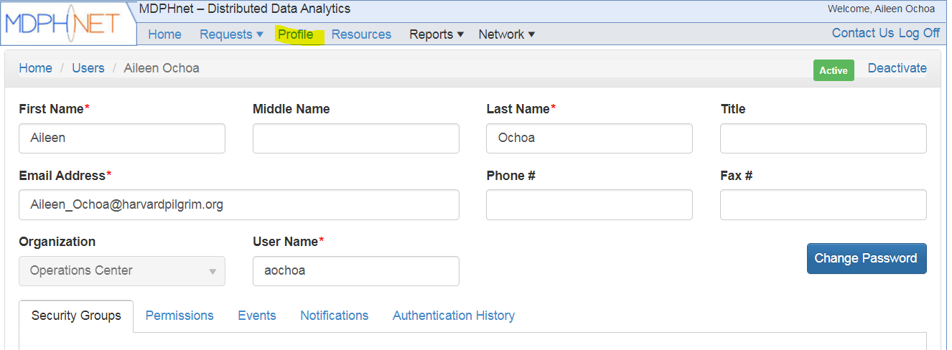
Password and Notifications
Click on Profile in the top menu to access your Account page. Then you can change your password here.
Click on the Notifications tab to change email notifications regarding your query (for admins, you can also choose to receive email when any query has been run at your site)

Slide 19
Helpful Tips
It might be easier to run multiple queries rather than submit one that has everything.
It is very common to run a query and realize after you view results that you need to make adjustments. You can easily open your original query, edit, then resubmit through the tool.
Commonwealth Informatics can provide guidance on a complicated query
It might be necessary to run a SQL script using SQL distribution request if the Query Composer can’t give the results you want.

Slide 20
Real World Example
Vickie Nielson had a question in 2017: Have there been changes in IUD utilization in Massachusetts?
Query written for counts of Females aged 15 – 44 years, January 2015 to March 2017 with Encounter for Insertion of IUD (ICD-9 V25.11, ICD-10 Z30.430)
Used raw data from query to perform a Poisson Segmented Regression to assess changes of incidence over time
Next steps: 1) trend analyses 2) review data quality 3) compare trends to other contraceptives 4) review encounter types

Slide 21
More Information
Please see this link for all MDPHnet Query Tool materials
https://espnet.atlassian.net/wiki/spaces/EP/pages/42074142/MDPHnet+Users

