Slide 1
Harnessing EHRs to Enhance Reporting to the Vaccine Adverse Event Reporting System (VAERS)
Meghan Baker, MD, ScD
Aileen Ochoa, MPH
Katherine Yih, PhD, MPH
Michael Klompas, MD, MPH

Slide 2
The importance of vaccine surveillance
Vaccine use is prolific
Over 200 million vaccines administered annually in the US alone
>95% of school children vaccinated against ≥8 diseases
Accurate detection of vaccine adverse events is essential
Adverse events problematic since “hurting the healthy”
Helps assure the safety of national vaccine programs
Vaccine safety data from clinical trials incomplete
Controlled populations, small relative to eventual target population
Limited power to detect rare, idiosyncratic adverse effects

Slide 3
Two existing vaccine surveillance systems
ACTIVE SURVEILLANCE
PASSIVE SURVEILLANCE
Large, rigorous, multi-center epidemiologic studies in defined populations
Usually seeks statistically significant increases in pre-defined adverse events
e.g. CDC’s Vaccine Safety Datalink
Spontaneous reporting of possible adverse events after vaccines
Clinicians, drug companies, patients can report any possible adverse event
e.g. CDC/FDA’s Vaccine Adverse Event Reporting System (VAERS)

Slide 4
VAERS homepage

Slide 5
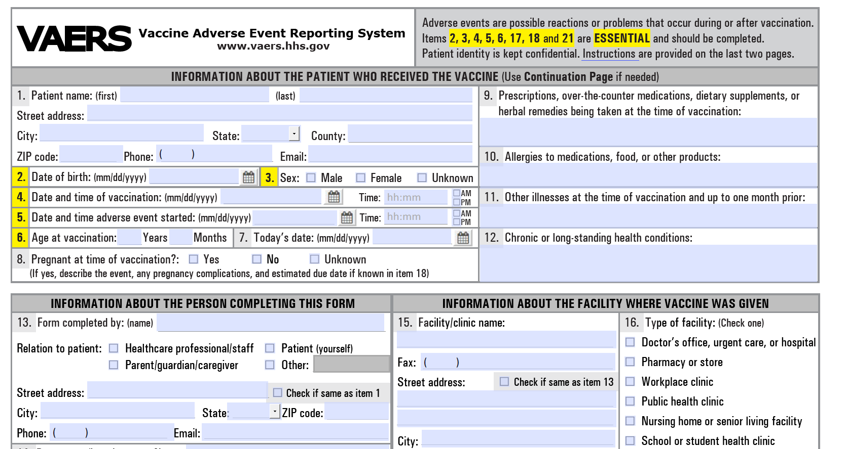
VAERS Paper Event Reporting Form https://vaers.hhs.gov/uploadFile/index.jsp

Slide 6
VAERS Background
Passive reporting system for suspected vaccine adverse events
54,000 reports annually
7% classified as serious
Reports vary in quality and completeness
6% lack a compete vaccination date
10% lack a complete adverse event onset date
Many lack lot numbers
Unknown amount of under-reporting
JAMIA, 2007;14:721-735
Vaccine, 2015;33(36):4398-4405
http://vaers.hhs.gov/index

Slide 7
Strengths of VAERS
Detects new, unusual or rare vaccine adverse events
May detect increases in known adverse events
Best source for early indications of potential new vaccine safety problems
E.g., reports of intussusception after RotaShield (original rotavirus vaccine licensed in 1998); manufacturer ultimately withdrew it from market in 1999
Such signals often followed by large, population-based studies to confirm or rule them out
Data are made available to the public via an open website
Vaccine, 2015;33(36):4398-4405
http://vaers.hhs.gov/index

Slide 8
Weaknesses of VAERS
Under-reporting
Clinicians may not link patient’s illness to recent vaccine
May not be aware of VAERS
May be deterred by the labor required to report
Stimulated reporting
Increased reporting in response to increased media attention and public awareness
Statistical relevance of reports unclear
Denominators and comparators not apparent
Can’t determine if vaccine is cause of the adverse event
Vaccine, 2015;33(36):4398-4405
http://vaers.hhs.gov/index

Slide 9
Our objectives
Computer-assisted,
Clinician-directed SURVEILLANCE
ACTIVE SURVEILLANCE
PASSIVE SURVEILLANCE
Improve vaccine safety surveillance by combining the completeness of active surveillance with the sensitivity to rare events and clinical input of passive surveillance
Improve efficiency & usability by integrating surveillance into clinicians’ electronic medical record workflows

Slide 10
Leverage the ESP EHR-based public health surveillance platform
Software and architecture to automate public health surveillance and reporting using electronic health record data
Audits codified EHR data for conditions of public health interest
Generates and transmits secure electronic reports to health departments (case reports for infections, aggregate summaries for chronic disease)
Includes modules for:
communicable diseases
influenza-like illness
chronic diseases
vaccine adverse effects
Am J Public Health 2017; 107(9): 1406-1412
Am J Public Health 2014; 104(12): 2265-70
JAMIA 2009;16:18-24 MMWR 2008;57:372-375

Slide 11
ESP Vaccine Safety Surveillance Module
Created 2012-2014
Detect possible adverse events after vaccination
Seek clinician endorsement and invite annotation
Submit pre-populated electronic reports to VAERS of clinician endorsed potential adverse vaccine reactions
Updated 2019
Added ICD-10 codes to algorithm
Added broader exclusion rules to reduce false positive alerts
Added new fields from VAERS 2.0 form

Slide 12
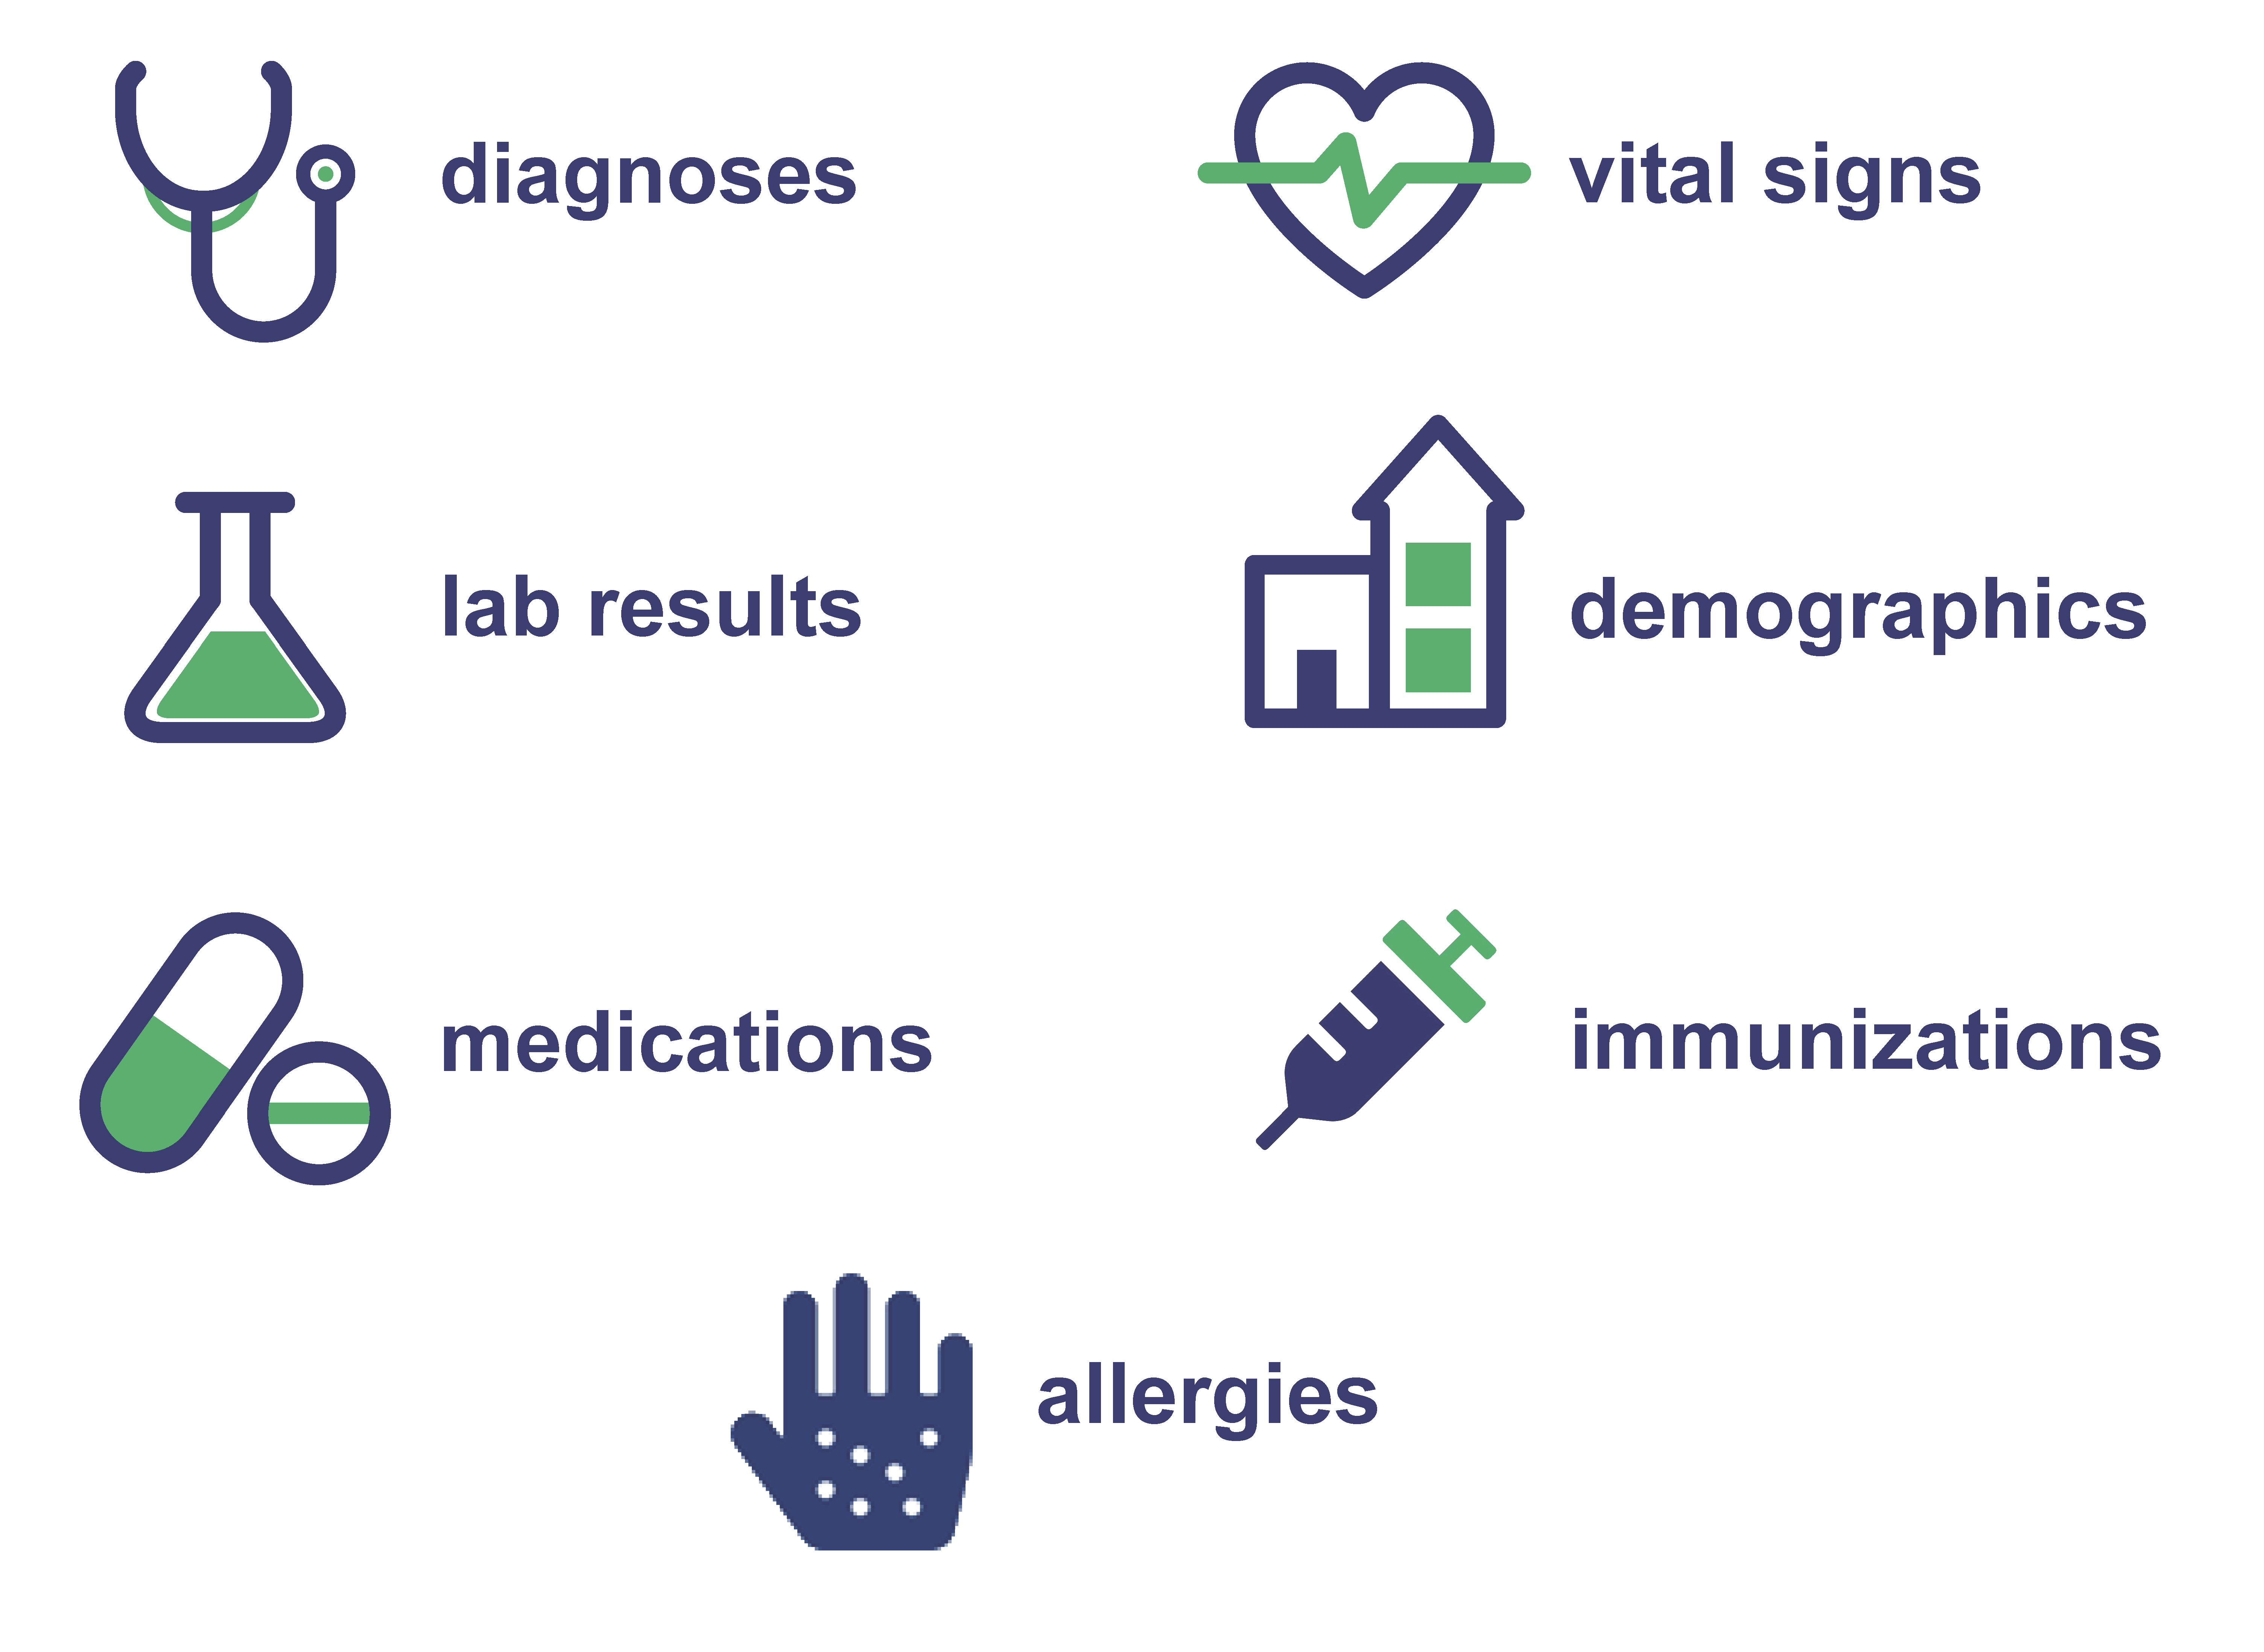
ESP: Automated detection and reporting of notifiable conditions
Am J Public Health 2017; 107(9): 1406-1412
JAMIA 2009;16:18-24

Slide 13
Automated detection and reporting to VAERS
VAERS algorithm detects possible Adverse Event (AE)
ESP sends message to clinician for review
ESP Server at Clinical Site
Clinician confirms or denies AE
CDC/FDA
If appropriate,
ESP creates report and sends to VAERS
HL7 Electronic VAERS Report
Am J Public Health 2017; 107(9): 1406-1412
Clinical Infectious Diseases 2015; 61(6): 864–870
JAMIA 2009;16:18-24

Slide 14
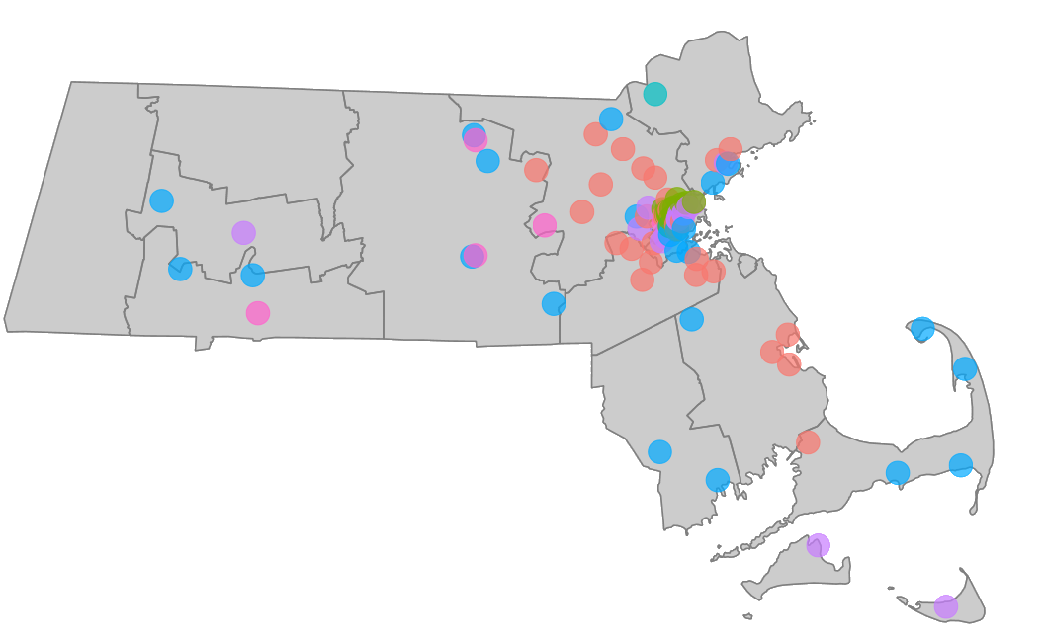
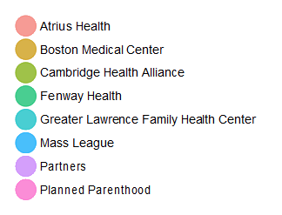
ESP Installations
Massachusetts
Ohio
Cambridge Health Alliance - network of three hospitals and 15 community health centers.
Approximately 140,000 patients and 600 medical staff
MetroHealth, Cuyahoga County, Ohio
Approximately 373,000 patients and > 900 medical staff

Slide 15
How the algorithm works
ESP prospectively follows each patient for 42 days following vaccination
If the patient has an encounter within 42 days of vaccination, ESP assesses the record for new ICD codes, lab results, or allergies that might indicate an adverse event from vaccination
Query patient’s prior record – if condition was pre-existing then discard
If a possible adverse event is found, a message is sent to the clinician’s secure in-basket describing the event and inviting comment
If clinician concurs or does not respond to a serious event or an event in the list of reportable events after vaccination, submit an HL7 report to VAERS

Slide 16
Detection of Adverse Events
Diagnoses: ICD-10 codes
VAERS Table of Reportable Events
Any new diagnosis unless on (extensive) exclusion list
Immunization-related adverse effect codes
Lab results: hemoglobin, WBC, platelets, creatinine

Slide 17
Detection of Adverse Events (continued)
VAERS report automatically sent if no response from clinician
Anaphylaxis
Brachial neuritis after tetanus vaccine
Encephalitis
Myelitis
Encephalopathy
Paralytic syndromes
Thrombocytopenic purpura
Infection due to vaccine
Immunization reaction
Fever
Seizures resulting in a hospitalization
Syncope
VAERS report requiring clinician approval
All other possible adverse events identified
Examples
Rash
Cellulitis
Local immunization reaction

Slide 18
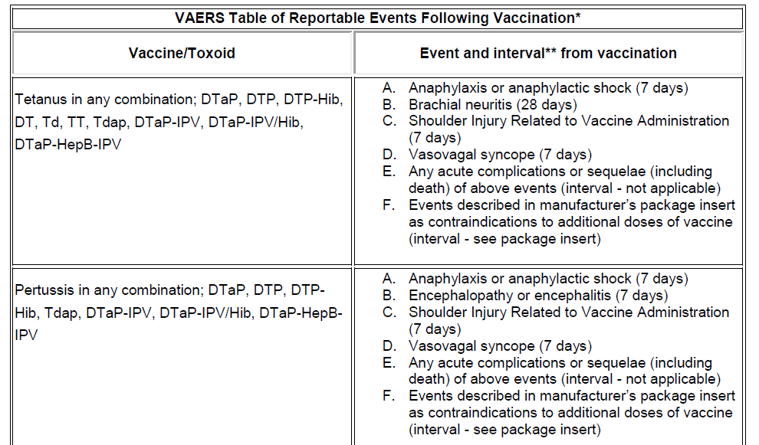
Full document available at https://vaers.hhs.gov/docs/VAERS_Table_of_Reportable_Events_Following_Vaccination.pdf

Slide 19
Triaging ICD10 codes
ICDs already associated with adverse events or identified in the VAERS reportable events table e.g. seizure, Guillain-Barré, intussusception
query clinician, report automatically if no response
ICDs possible adverse events e.g. myocarditis, lymphadenopathy, laryngitis
query clinician, report if clinician agrees
ICDs unlikely to be vaccine related e.g. periodic health exam, broken bones, med refills
Automatically discarded

Slide 20
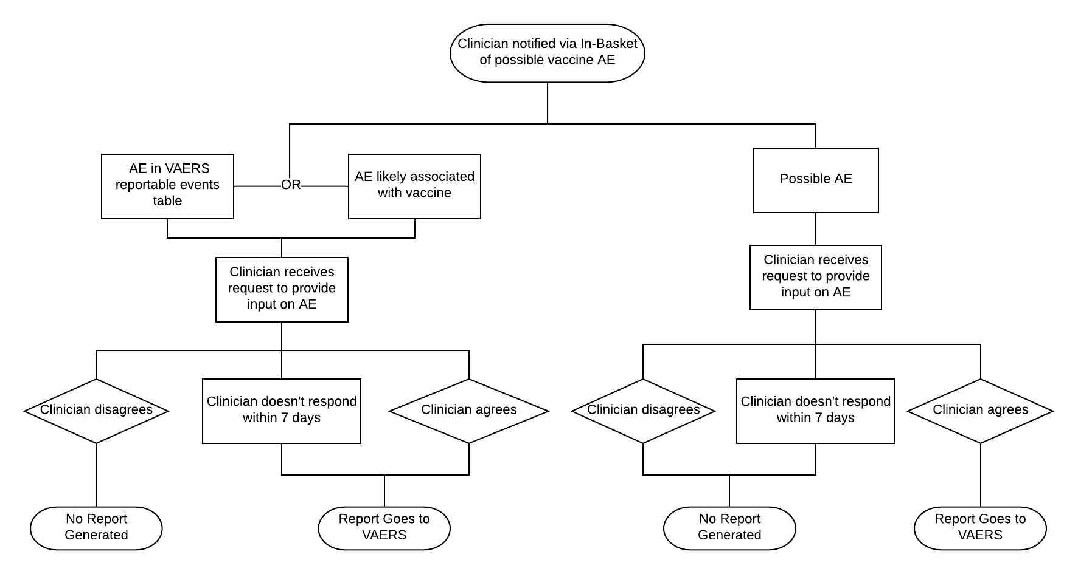

Slide 21
Example ESP-VAERS Logic
Day 9 – patient has routine lab work – creatinine 2.3
Assess patient’s past encounters : last creatinine 2.2
Stop
Day 0 – influenza vaccine administered
1
2
3
4
5
6
7
8
9
10
0

Slide 22
Example ESP-VAERS Logic
Day 6 – patient diagnosed with meningitis
Assess patient’s past encounters → no ICD10 for meningitis in the past year
Send message to patient’s clinician “could this be related to recent vaccine?”
No → stop
Yes → invite clinician to add comments
Send HL7 report to VAERS
Day 0 – measles vaccine administered
1
2
3
4
5
6
7
8
9
10
0

Slide 23
Clinician notification message
Dear Dr. JONES
Your patient, Sam Adams was recently diagnosed with a reportable vaccination adverse reaction.
Sam Adams was recently noted to have MENINGITIS
Sam Adams was vaccinated with MEASLES VACCINE on AUGUST 12 2019
Can you confirm your patient experienced an adverse event (a possible side effect) of a vaccination? If you wish, we can submit an electronic report to the CDC/FDA's Vaccine Adverse Event Reporting System (VAERS) on your behalf.
Please click the link below to review and comment on this issue.
Review and comment on this issue at: [URL]

Slide 24
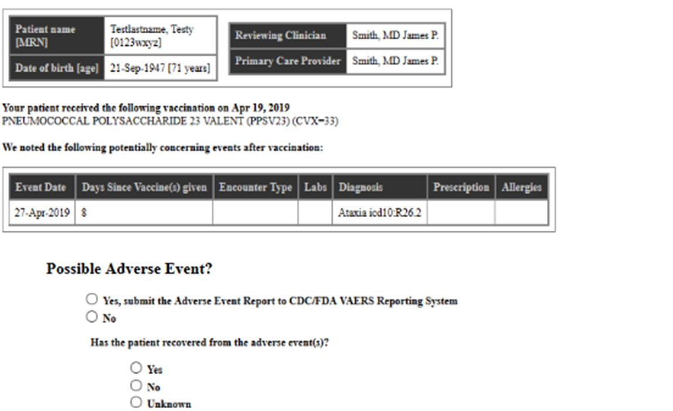
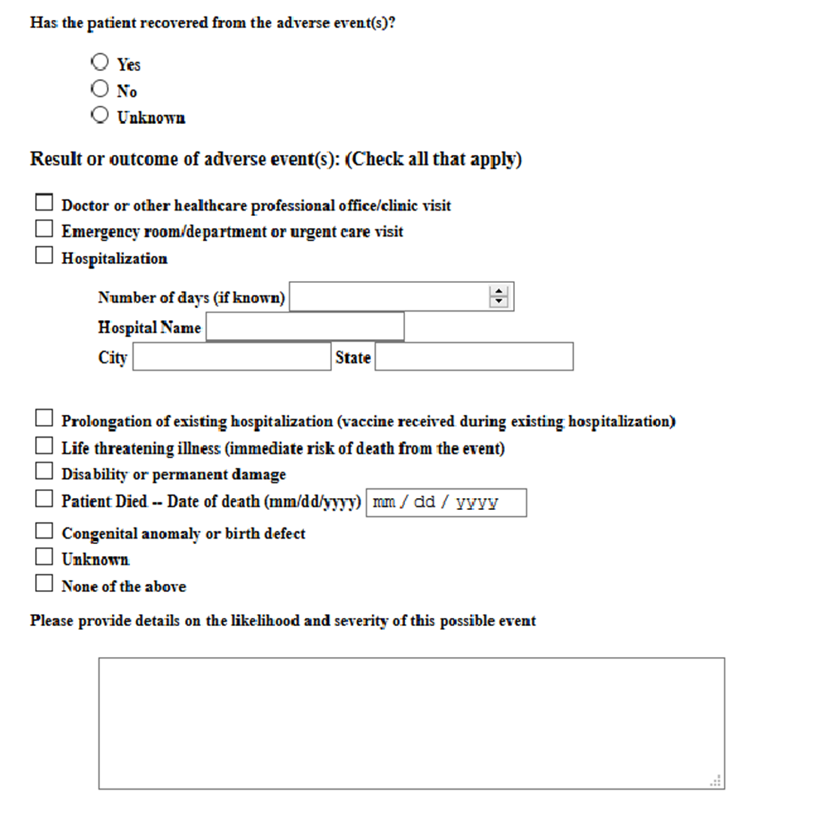
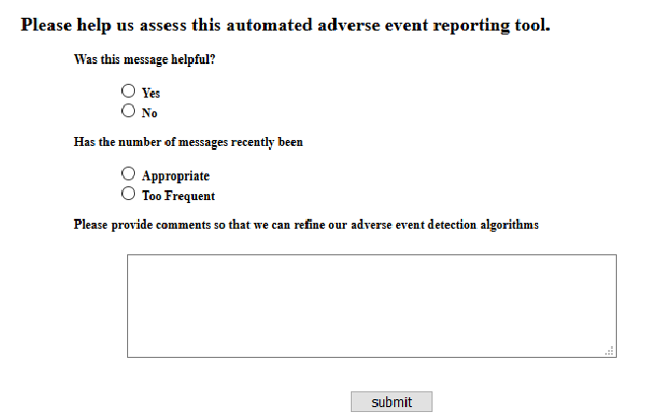
Clinician input screen
These questions only applicable if clinician answers “yes” to first question

Slide 25
Messages to VAERS
HL7 version 2.3.1
Conveyed using Public Health Information Network Messaging System (PHIN-MS), a bi-directional and secure messaging platform maintained by CDC
Report includes
Patient name, gender, date of birth, contact
Reporting clinician name and contact
Vaccine name, lot number, date of administration
Adverse event, date, value
Result or outcome of Adverse Event (such as ER visit/hospitalization)
Other vaccinations within 4 weeks
Clinician comments

Slide 26
Vaccines administered Dec 2012 through July 2013
Results from 2013 Pilot at MetroHealth
Vaccine | Count (n, %)
Tdap | 15,279 (16.7)
Influenza, inactivated (IIV) | 13,629 (14.9)
PCV13 | 7561 (8.3)
Hib | 7051 (7.7)
Hepatitis A pediatric | 6508 (7.1)
HPV | 5424 (5.9)
DTaP-hepatitis B-IPV | 5099 (5.6)
PPSV23 | 4230 (4.6)
Pentavalent rotavirus | 3087 (3.4)
Other vaccines | 23,754 (25.9)
Clinical Infectious Diseases 2015; 61(6): 864–870

Slide 27
VAERS reports sent Dec 2012 through July 2013 (n=32)
Results from 2013 Pilot at MetroHealth
Clinically confirmed (n=16)
Automatically Sent, ICD-9 codes for immunization reaction (n=16)
Adverse Event | Vaccine Administered
Seizure | IIV
Eosinophilia | IIV
 | PCV13
Bell’s palsy | Tdap
Pleural effusion | IIV, Tdap
Lymphocytopenia | Tdap
Leukopenia | Tdap
Cellulitis | DTaP-IPV, MMRV
Febrile seizures, rash | MMR, varicella
Viral exanthem, rubella Symptoms | DTaP, hepatitis B, IPV, Hib, IIV, MMR, varicella, PCV13
Fever and mild neutropenia | PPSV23
Rash | DTaP-IPV, MMRV
 | Hepatitis A, Hib, MMR, PCV13,varicella
 | Hepatitis A, MMRV
Fever | DTaP-hepatitis B-IPV, Hib, PCV13, rotavirus
Hypothyroidism | Shingles, Tdap
Adverse Event | Vaccine Administered
Reaction to vaccine–possible allergic reaction | IIV
Fever, local immunization reaction | DTaP-IPV, MMRV
Rash, fever | Hepatitis A, MMR, varicella
Rash, fever | Hepatitis A, MMR, varicella
Fever | DTaP-hepatitis B-IPV, Hib, PCV13, rotavirus
Cellulitis | IIV, meningococcal
Fussiness | Hepatitis A, MMRV
Local immunization reaction | DTaP-IPV, MMRV
 | DTaP-IPV, hepatitis A, MMRV
 | Hepatitis A, MMR, varicella
 | HPV, meningococcal, Tdap
 | IIV
 | IIV, PPSV23, Tdap
 | PPSV23
 | Shingles
 | Tdap
Clinical Infectious Diseases 2015; 61(6): 864–870

Slide 28
Vaccine Adverse Event Reporting system messages sent before and during pilot study period
Results from 2013 Pilot at MetroHealth
MetroHealth Data | # of VAERS Reports | Time Period | # of Reports/Month | # of Vaccinations | # of Reports/100,000 vaccinations
Pre-implementation data | 3 | 27 mos | 0.11 | 274,080 | 1.09
Implementation data | 32 | 8 mos | 4 | 91,622 | 34.9
12-fold increase in absolute reporting rate (3 vs 32)
17-fold increase in dose-based reporting rate (1.09 vs. 34.9)
The odds of submitting a VAERS report during the pilot period were 30.2 times greater than the odds of submitting a VAERS report during the pre-pilot period.
Clinical Infectious Diseases 2015; 61(6): 864–870
Notes:
30.2 times after adjusting for calendar time

Slide 29
Provider Feedback
55% (115/209 clinicians who left feedback) found the messages helpful
79% (166/209) stated the number of messages was appropriate
Clinical Infectious Diseases 2015; 61(6): 864–870

Slide 30
Summary
ESP VAERS can increase vaccine adverse event detection and reporting rates
Helps identify potential events for clinical review
Allows clinicians to review, confirm, and comment upon potential adverse events
Facilitates reporting to VAERS compared with conventional manual or electronic reporting
Detected and reported events have credible face value
Visit https://espnet.atlassian.net/wiki/x/AYCXM for information on implementing ESP

Slide 31
ESP Team
Dept of Population Medicine, Harvard Pilgrim Health Care/Harvard Medical School
Richard Platt
Meghan Baker
Katherine Yih
Aileen Ochoa
Michael Klompas
Micaela Coady
Commonwealth Informatics
Bob Zambarano
Chris Wright
MetroHealth
David Kaelber
David Bar-Shain
Janeen Leon
Cambridge Health Alliance
Brian Herrick
Michelle Weiss
CDC
Pedro Moro
Bonita Johnson
Maria Cano
Paige Marquez
Traci Roberts
Tom Shimabukuro
www.esphealth.org

