Slide 1
Harnessing EHRs to Enhance Reporting to the Vaccine Adverse Event Reporting System (VAERS)
Presenter Name

Slide 2
Benefits
ESP VAERS can increase vaccine adverse event detection and reporting rates
Helps identify potential events for clinical review
Allows clinicians to review, confirm, and comment upon potential adverse events
Facilitates reporting to VAERS compared with conventional manual reporting
Detected and reported events have credible face value
Visit https://espnet.atlassian.net/wiki/x/AYCXM for information on implementing ESP

Slide 3
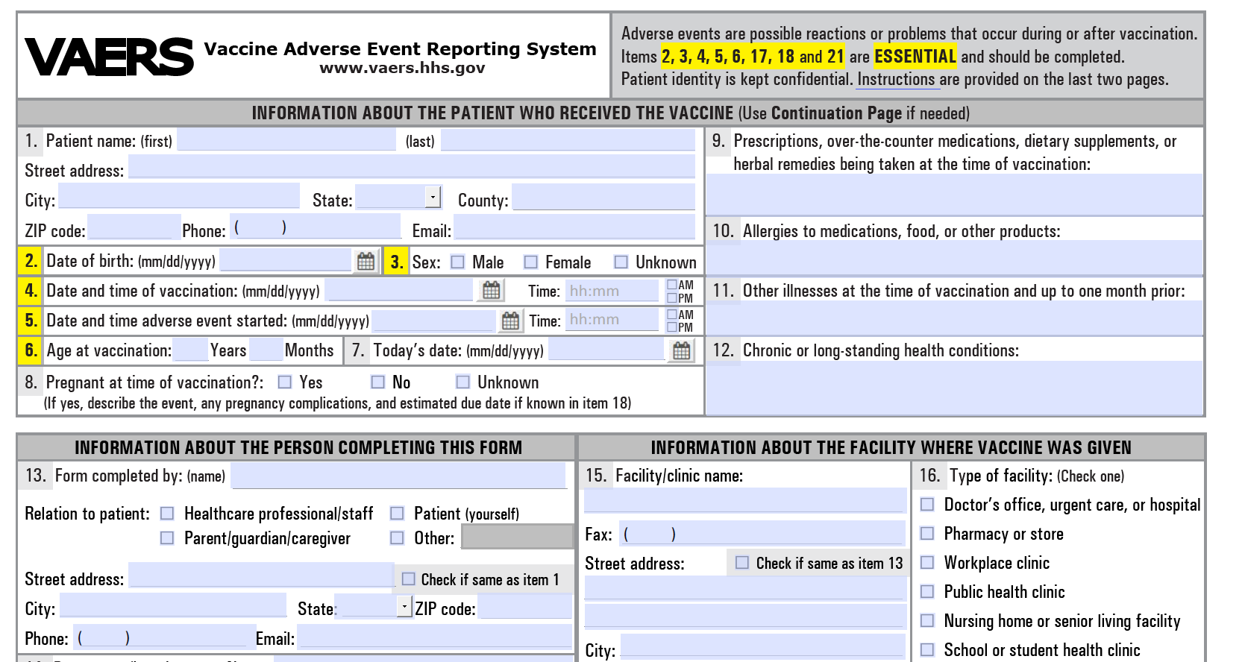
VAERS Paper Event Reporting Form https://vaers.hhs.gov/uploadFile/index.jsp

Slide 4
Automated detection and reporting to VAERS
VAERS algorithm detects possible Adverse Event (AE)
ESP sends message to clinician for review
ESP Server at Clinical Site
Clinician confirms or denies AE
CDC/FDA
If appropriate,
ESP creates report and sends to VAERS
HL7 Electronic VAERS Report
Am J Public Health 2017; 107(9): 1406-1412
Clinical Infectious Diseases 2015; 61(6): 864–870
JAMIA 2009;16:18-24

Slide 5
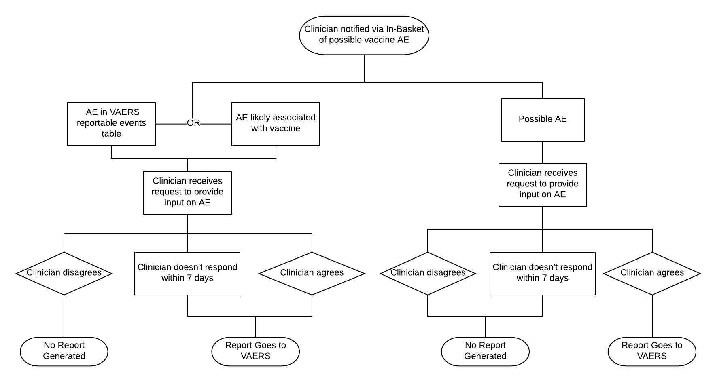

Slide 6
Example ESP-VAERS Logic
Day 9 – patient has routine lab work – creatinine 2.3
Assess patient’s past encounters : last creatinine 2.2
Stop
Day 0 – influenza vaccine administered
1
2
3
4
5
6
7
8
9
10
0

Slide 7
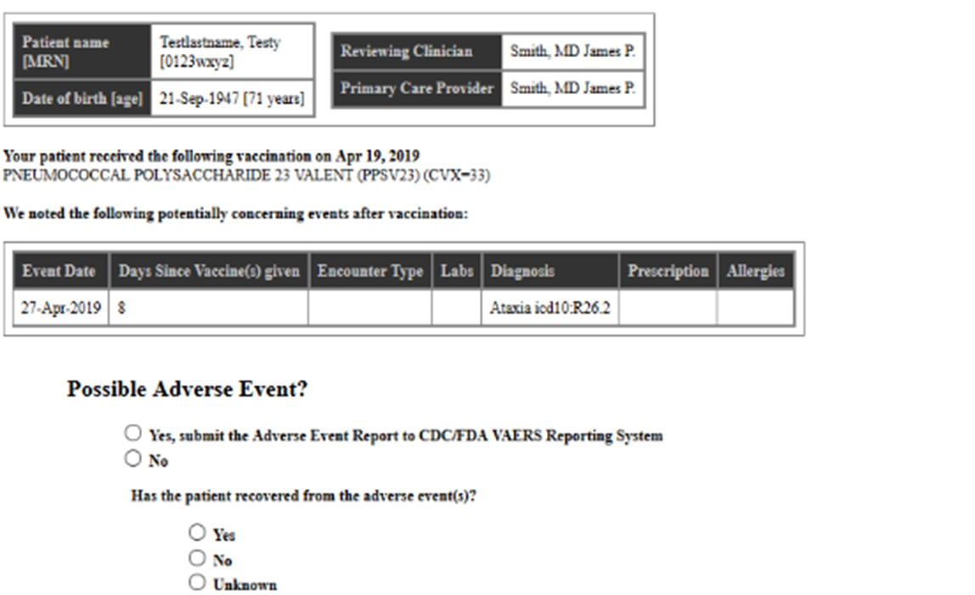
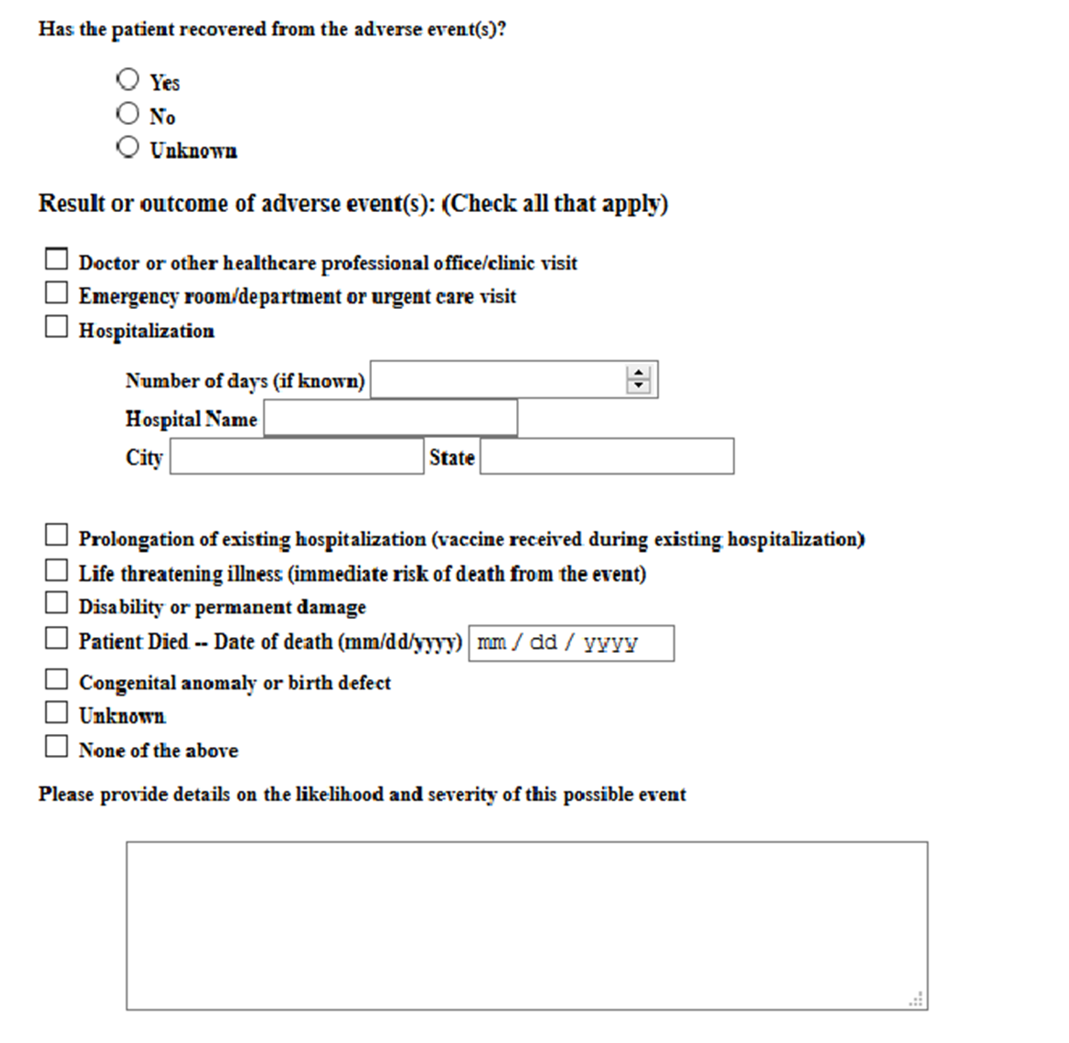
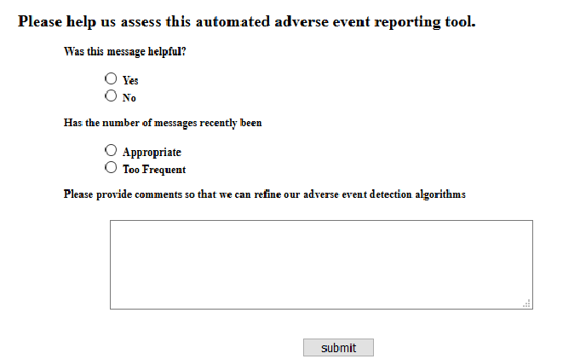
Clinician input screen
These questions only applicable if clinician answers “yes” to first question

Slide 8
ESP Team
Dept of Population Medicine, Harvard Pilgrim Health Care/Harvard Medical School
Richard Platt
Meghan Baker
Katherine Yih
Aileen Ochoa
Michael Klompas
Micaela Coady
Commonwealth Informatics
Bob Zambarano
Chris Wright
MetroHealth
David Kaelber
David Bar-Shain
Janeen Leon
Cambridge Health Alliance
Brian Herrick
Michelle Weiss
CDC
Pedro Moro
Bonita Johnson
Maria Cano
Paige Marquez
Traci Roberts
Tom Shimabukuro
www.esphealth.org

